Slide 1
GHG Emission Analysis
-Joel Gracelin

Slide 2
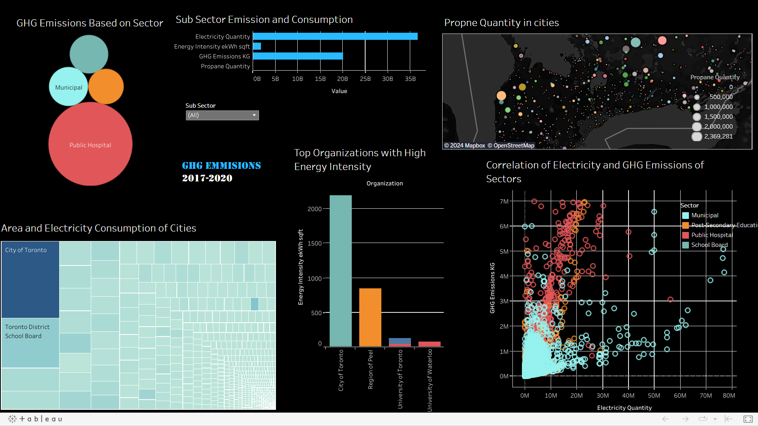

Slide 3
Problem Statement
Problem Statement:
Project will analyze energy usage and greenhouse gas (GHG) emissions of Ontario's Broader Public Sector (BPS) organizations, leveraging a comprehensive database of reported data. We aim to identify trends, assess conservation effectiveness, and pinpoint areas for improvement, informing data-driven strategies to achieve climate change mitigation goals within the BPS.

Slide 4
Tools Used
Tools Used
Excel
Python - Data Cleaning and Pre-Processing
Tableau- Data Visualizations (https://public.tableau.com/views/GHGEmissions_17070490990470/Dashboard1?:language=en-US&:display_count=n&:origin=viz_share_link)

Slide 5
Approaches
The data was collected and was skimmed in excel
The data was then loaded in jupyter notebooks to check for inconsistent column names then added on axis=0 ( row order)
The data was then checked for null and duplicated and was dealt accordingly
The outliers were identified and through visualization and was replaced with mean for consistency.
The cleaned data is then moved to Tableau for visualizations

Slide 6
EDA Insights
Crucial insights
The data revealed that Hospitals are the highest contributor for GHG
The higher use of electricity doesnt always mean a higher GHG emission but rather propane can be traced to have a considerable impact
The data reveals that colleges and dorms consume more energy in a regular basis since the higher amount of people

Slide 7
Conclusion
The analysis project helped me brush up my Tableau skills and also my logical reasoning
The data cleaning step proved to be very important since the inconsistencies of the data skewed the visualizations
I realized the importance of outlier handling since some outliers were way off from the rest.
THough the outliers may be actual values but they affect the remaining value distribution in visualizations

